Slide 1
ANCOVA

Slide 2
ANCOVA – Analysis of Covariance
ANOVA (Analysis of Variance) is used to compare the mean response of two or more categorical variables.
ANCOVA is an extension of ANOVA, “ANOVA with covariates”, or simply, a combination of ANOVA and regression. ANCOVA can be used to compare the mean response of two or more categorical variables, after covariate effect is removed.
Advantage of ANCOVA:
To control error and thereby to increase precision.
To adjust treatment means of the dependent variable for differences in the values of corresponding independent variable.

Slide 3
ANCOVA – Analysis of Covariance

Slide 4
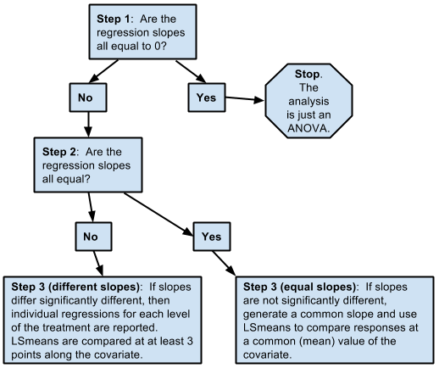
ANCOVA Procedure
https://newonlinecourses.science.psu.edu/stat502/node/186/

Slide 5
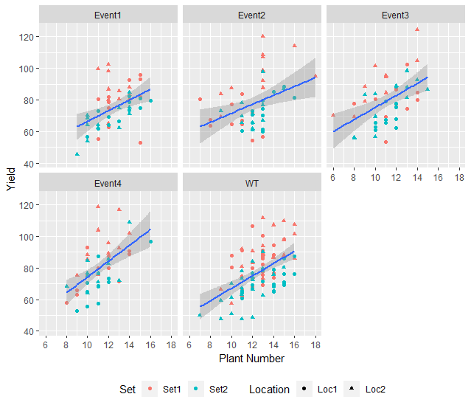

Slide 6
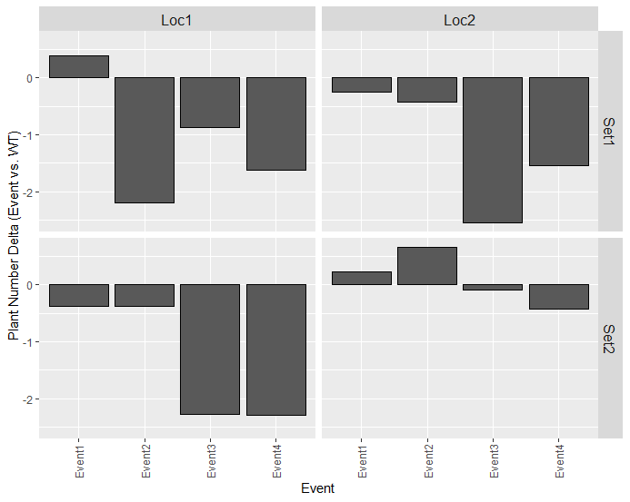

Slide 7
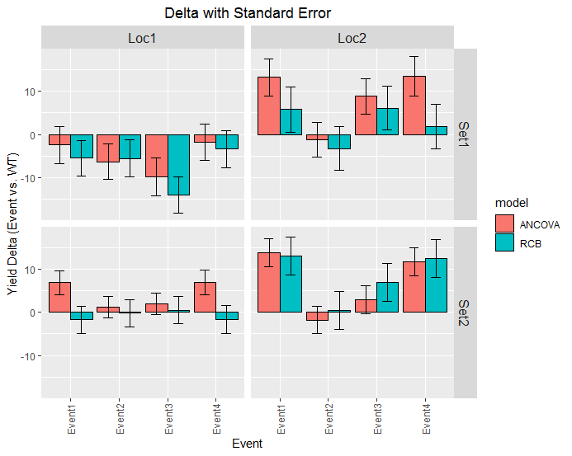

Slide 8
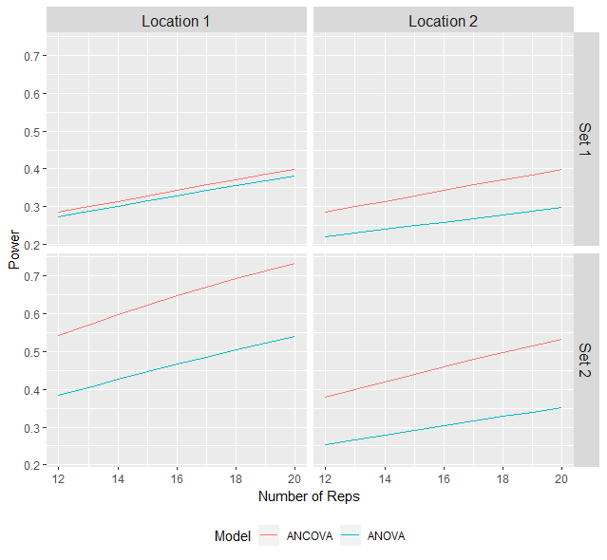
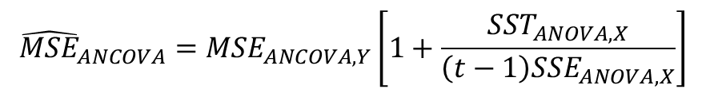
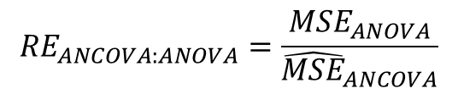
Relative Efficiency of ANCOVA
$${\hat{MSE}}_{ANCOVA}={MSE}_{ANCOVA,Y}\left[1+\frac{{SST}_{ANOVA, X}}{\left(t−1\right){SSE}_{ANOVA,X}}\right]$$
delta = 5, alpha = 0.05
$${RE}_{ANCOVA:ANOVA}=\frac{{MSE}_{ANOVA}}{{\hat{MSE}}_{ANCOVA}}$$
Set | Location | RE
Set 1 | Location 1 | 1.04
Set 1 | Location 2 | 1.47
Set 2 | Location 1 | 1.38
Set 2 | Location 2 | 2.07

Slide 9

Summary
Plant Number is positively correlated with Yield
ANCOVA can effectively adjust entry means of the Yield for differences in the values of corresponding Plant Number
ANCOVA with Plant Number as covariate can improve our test sensitivity, thus increase power

